Slide 1
Visualization of Nautical Information
VONI workshop
Notes:
My ideas for the workshop

Slide 2
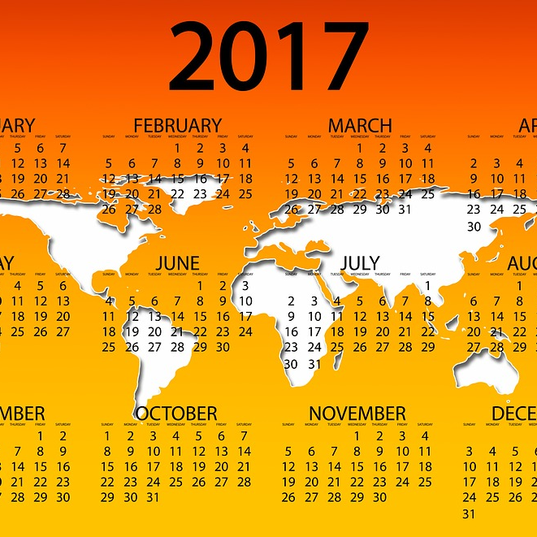
Mark
your calendars
When | May 23-25th, 2017
Where | University of New Hampshire, Durham, NH USA
Who | subject matter experts (you...HO’s)
 | technical experts (your developer of choice)
 | industry experts (you….non-HO’s)
 | acadamia (me, others?)
Why | ...that’s the rest of this presentation…..stay with me….

Slide 3
NIPWG4
NOTE: There is a proposal to combine the workshop with NIPWG4.
Due to budget constraints that most HOs are confronted with.
Take a whole week meeting with the workshop to be conducted for 2-3 days.
It is proposed to have longer days if we see the need to address all VONI/NIPWG items.

Slide 4
Three days to...
discuss
envision
plan

Slide 5
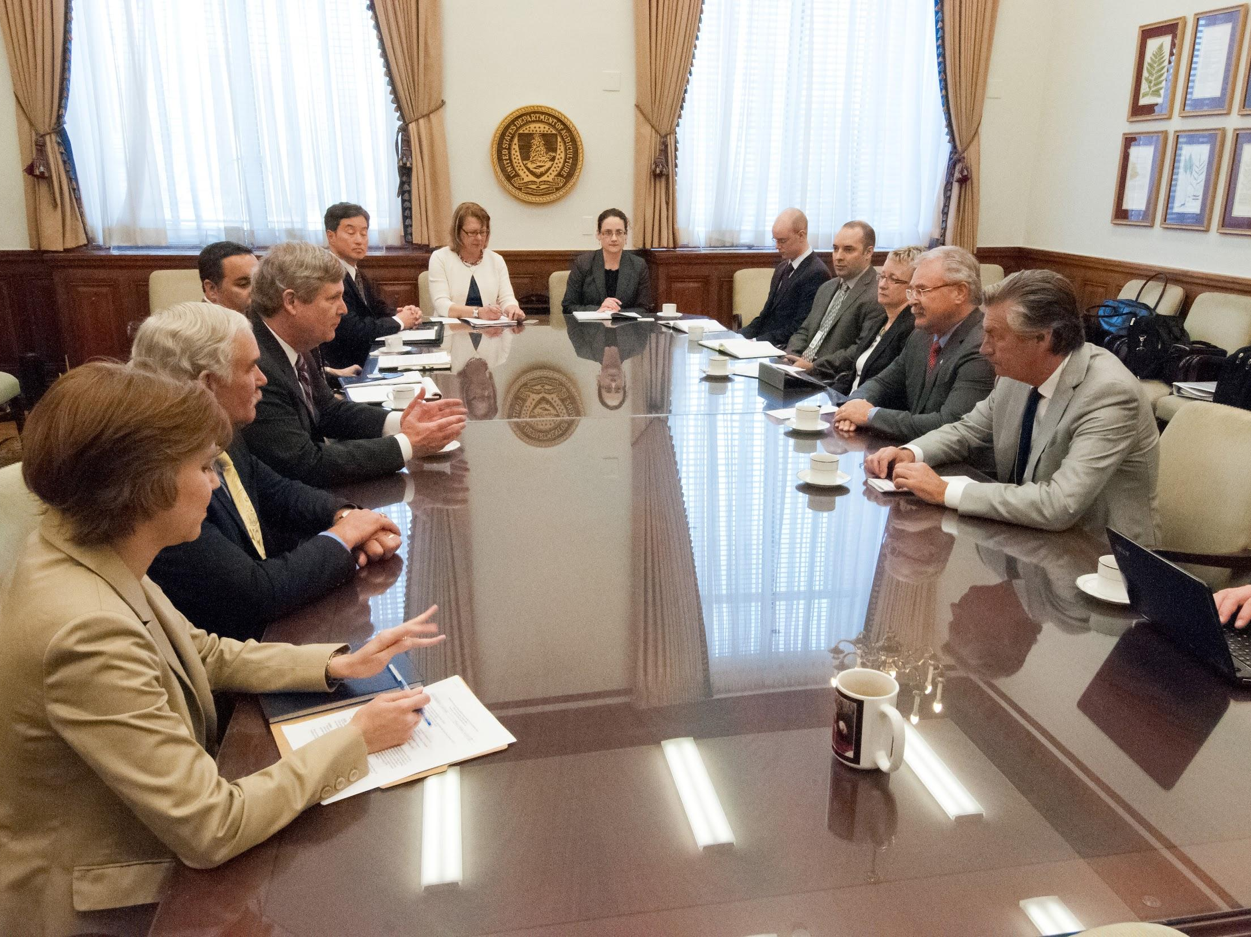
Discuss

Slide 6
You don’t know where you’re going until you know where you’ve been.
Notes:
-old english proverb

Slide 7

Production System
How are you doing it?

Slide 8

Feedback from HO’s
Production System Questionnaire

Slide 9
Day 1.
Discuss
How things currently work in each HO

Slide 10
HO Production System
Overview of responses
Sample data
Open discussion about issues, desires, needs, goals
Notes:
An introduction of member states current production systems for publications (brief papers)
brief papers - possibly send out an organized template for the paper that lists sections for each of NIPWG's product specifications.
If something of their data isn't represented in the outline, they should add it at the end to make sure we know what doesn't have a home.
requested in advance of meeting for all to look over and become familiar with.THIS SHOULD BE MANDATORY BY ALL ATTENDEES and accompany their registration for the event.
sample data
from their system so developers can brainstorm ideas/solutions too. THIS SHOULD BE MANDATORY BY ALL ATTENDEES and accompany their registration for the event.

Slide 11
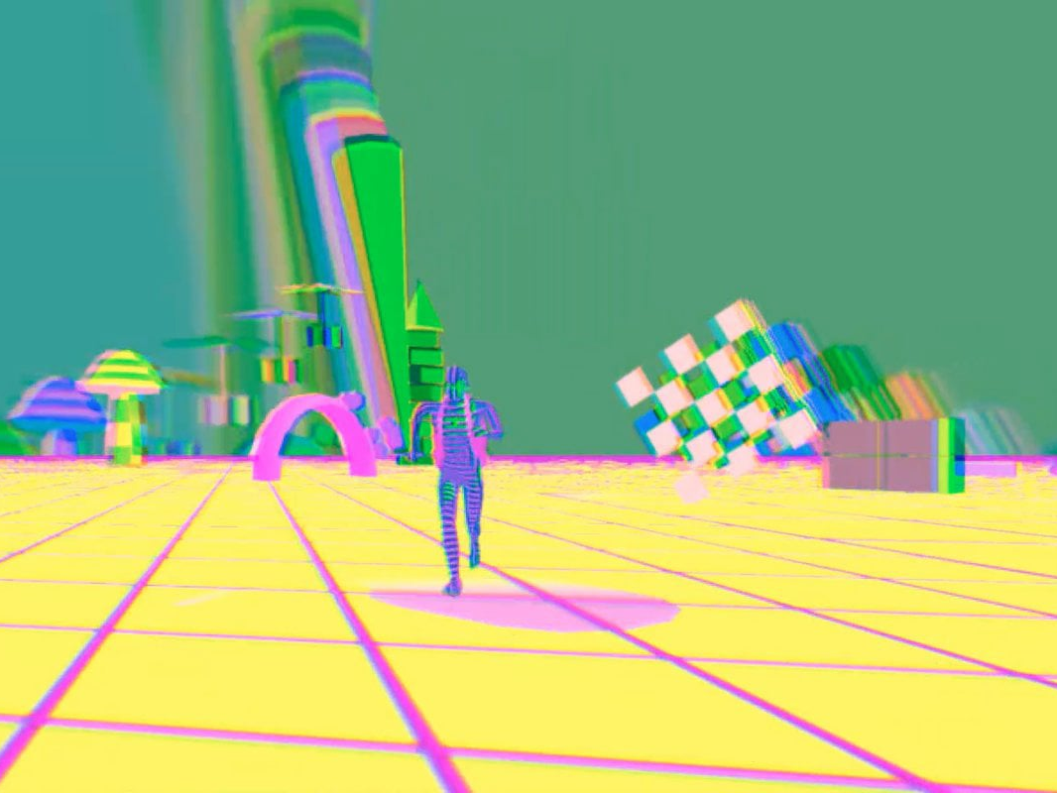
Envision

Slide 12
The first step toward creating an improved future is developing the ability to envision it.
Notes:
Tony Dungy

Slide 13

Visualization System
How are they viewing it?

Slide 14
Day 2.
Envision
Who is visualizing what?

Slide 15
Visualizations
S-100 Viewer (ROK)
DCEG Viewer
Antropocene Institute: MPA S-122 vis
WR Systems: S-101, S-102 (and S-111)
Rose Point
Garmin
CARIS visualization systems
ChUM - Chart Updates Mashup (NtM)
iCPilot - Interactive Coast Pilot
Jeppesen(?)
Others?
Notes:
S-100 Viewer (ROK)
DCEG Viewer
Anthropocene Institute: test-bed for MPA S-122 visualizations
WR Systems: test-bed for S-101, S-102 (and S-111!)
CARIS visualization systems
Jeppesen (?)
ChUM - Chart Updates Mashup (briana's critical chart corrections visualization from Notice to Mariners)
iCPilot - interactive Coast Pilot (briana’s visualization tool for physical environment)

Slide 16

Plan

Slide 17
By failing to prepare, you are preparing to fail
Notes:
Benjamin Franklin

Slide 18
Future System
How will we do it?

Slide 19
Day 3.
Plan
How do we get there?

Slide 20
Planning
Whiteboard sketches of ideas
Task dependant data/use cases
Metadata
Attributes and features in catalogue and the end product
data structure ideas
Visual output for ECDIS and for public discovery
Break out sessions for task groups
Notes:
Open discussion of the planned end result of the product specifications (white board sketches are fine)...
what information is needed during which tasks?
What is simply metadata and how will that be accessed?
How do the attributes and features discussed in the meetings tie into the ultimate XML product that is expected from the product specifications developed?
Ideas for data structure and examples to show why different structures produce different visualization results.
Visual outputs in ECDIS, and for public discovery (i.e. websites - this would suggest a "universal" interface for display for countries who want guidance, but allow conversation to be had on ideas)
possible break out sessions for task groups….the day could be broken up into specifications (to focus on one at a time).

Slide 21
Thanks!
Any comments?
You can find me at:
briana@ccom.unh.edu

